Slide 1

𝓓𝓲𝓰𝓲𝓽𝓪𝓵 𝓟𝓸𝓻𝓽𝓯𝓸𝓵𝓲𝓸
NAME:S NUSRATH FATHIMA
REG. NO./NMID:34624U18061/astvum24608
DEPARTMENT :B.Sc. COMPUTER SCIENCE
COLLEGE :MMES WOMEN’S ARTS AND SCIENCE COLLEGE
UNIVERSITY :THIRUVALLUVAR UNIVERSITY

Slide 2
CONTENTS
1.𝓟𝓡𝓞𝓑𝓛𝓔𝓜 𝓢𝓣𝓐𝓣𝓔𝓜𝓔𝓝𝓣
2.𝓟𝓡𝓞𝓙𝓔𝓒𝓣 𝓞𝓥𝓔𝓡𝓥𝓘𝓔𝓦
3.𝓔𝓝𝓓 𝓤𝓢𝓔𝓡𝓢
4.𝓣𝓞𝓞𝓛𝓢 𝓐𝓝𝓓 𝓣𝓔𝓒𝓗𝓝𝓞𝓛𝓞𝓖𝓘𝓔𝓢
5.𝓟𝓞𝓡𝓣𝓕𝓞𝓛𝓘𝓞 𝓓𝓔𝓢𝓘𝓖𝓝𝓢 𝓐𝓝𝓓 𝓛𝓐𝓨𝓞𝓤𝓣𝓢
6.𝓕𝓔𝓐𝓣𝓤𝓡𝓔𝓢 𝓐𝓝𝓓 𝓕𝓤𝓝𝓒𝓣𝓘𝓞𝓝𝓐𝓛𝓘𝓣𝓘𝓔𝓢
7. 𝓡𝓔𝓢𝓤𝓛𝓣𝓢 𝓐𝓝𝓓 𝓢𝓒𝓡𝓔𝓔𝓝𝓢𝓗𝓞𝓡𝓣𝓢
8.𝓒𝓞𝓝𝓒𝓛𝓤𝓢𝓘𝓞𝓝
9.𝓖𝓘𝓣-𝓗𝓤𝓑 𝓛𝓘𝓝𝓚

Slide 3
Problem STATEMENT :
1.𝓗𝓲𝓻𝓲𝓷𝓰 𝓮𝔁𝓹𝓮𝓻𝓲𝓮𝓷𝓬𝓮𝓭 𝓪𝓷𝓭 𝓺𝓾𝓪𝓵𝓲𝓯𝓲𝓮𝓭 𝔀𝓮𝓫-𝓭𝓮𝓿𝓮𝓵𝓸𝓹𝓮𝓻𝓼 𝓬𝓪𝓷 𝓫𝓮 𝓪 𝓭𝓲𝓯𝓯𝓲𝓬𝓾𝓵𝓽
𝓪𝓷𝓭 𝓽𝓲𝓶𝓮 -𝓬𝓸𝓷𝓼𝓾𝓶𝓲𝓷𝓰 𝓹𝓻𝓸𝓬𝓮𝓼𝓼 𝓯𝓸𝓻 𝓪𝓷 𝓸𝓻𝓰𝓪𝓷𝓲𝔃𝓪𝓽𝓲𝓸𝓷.
2.𝓡𝓮𝓬𝓻𝓾𝓲𝓽𝓮𝓻𝓼 𝓪𝓷𝓭 𝓱𝓲𝓻𝓲𝓷𝓰 𝓶𝓪𝓷𝓪𝓰𝓮𝓻𝓼 𝓼𝓹𝓮𝓷𝓭 𝓪𝓷 𝓮𝔁𝓬𝓮𝓼𝓼𝓲𝓿𝓮
𝓪𝓶𝓸𝓾𝓷𝓽 𝓸𝓯 𝓽𝓲𝓶𝓮 𝓼𝓲𝓯𝓽𝓲𝓷𝓰 𝓽𝓱𝓻𝓸𝓾𝓰𝓱 𝓻𝓮𝓼𝓾𝓶𝓮𝓼.
3. 𝓣𝓱𝓲𝓼 𝓵𝓮𝓪𝓭𝓼 𝓽𝓸 𝓼𝓵𝓸𝔀 - 𝓭𝓸𝔀𝓷 𝓽𝓱𝓮 𝓭𝓮𝓿𝓮𝓵𝓸𝓹𝓶𝓮𝓷𝓽 𝓸𝓯 𝓪𝓷
𝓸𝓻𝓰𝓪𝓷𝓲𝔃𝓪𝓽𝓲𝓸𝓷.
4. 𝓣𝓱𝓾𝓼, 𝓽𝓱𝓮 𝓳𝓸𝓫 𝓼𝓮𝓮𝓴𝓮𝓻𝓼 𝓯𝓪𝓲𝓵 𝓽𝓸 𝓹𝓻𝓸𝓿𝓲𝓭𝓮 𝓪 𝓹𝓸𝓻𝓽𝓯𝓸𝓵𝓲𝓸, 𝓽𝓱𝓪𝓽 𝓹𝓻𝓸𝓿𝓲𝓭𝓮𝓼 𝓪
𝓬𝓵𝓪𝓻𝓲𝓽𝔂 𝓸𝓯 𝓽𝓱𝓮𝓲𝓻 𝓼𝓴𝓲𝓵𝓵𝓼. 𝓣𝓱𝓾𝓼, 𝓮𝓪𝓼𝔂 𝓽𝓸 𝓱𝓲𝓻𝓮 𝓮𝓶𝓹𝓵𝓸𝔂𝓮𝓮𝓼.

Slide 4
PROJECT OVERVIEW :
1.𝓣𝓱𝓲𝓼 𝓼𝓮𝓬𝓽𝓲𝓸𝓷 𝓹𝓻𝓸𝓿 𝓲𝓭𝓮𝓼 𝔂𝓸𝓾 𝓪 𝓬𝓵𝓮𝓪𝓻 𝓲𝓭𝓮𝓪 𝓸𝓯 𝓪 𝓹𝓸𝓻𝓽𝓯𝓸𝓵𝓲𝓸
𝓭𝓮𝓼𝓲𝓰𝓷 𝓯𝓸𝓻 𝓪 𝓳𝓸𝓫𝓼𝓮𝓮𝓴𝓮𝓻.
2.𝓐 𝓹𝓸𝓻𝓽𝓯𝓸𝓵𝓲𝓸 𝓼𝓱𝓸𝓾𝓵𝓭 𝓬𝓸𝓷𝓽𝓪𝓲𝓷 𝓽𝓱𝓮 𝓼𝓮𝓬𝓽𝓲𝓸𝓷𝓼 𝓼𝓾𝓬𝓱 𝓪𝓼
𝓱𝓸𝓶𝓮, 𝓪𝓫𝓸𝓾𝓽, 𝓼𝓴𝓲𝓵𝓵𝓼, 𝓬𝓸𝓷𝓽𝓪𝓬𝓽.
3.𝓟𝓸𝓻𝓽𝓯𝓸𝓵𝓲𝓸 𝓬𝓻𝓮𝓪𝓽𝓮𝓼 𝓪 𝓬𝓵𝓮𝓪𝓻 𝓼𝓽𝓻𝓾𝓬𝓽𝓾𝓻𝓮 𝓸𝓯 𝓪 𝓹𝓮𝓻𝓼𝓸𝓷 𝓽𝓸 𝓱𝓲𝓻𝓮
𝓯𝓸𝓻 𝓪 𝓳𝓸𝓫.
4.𝓟𝓸𝓻𝓽𝓯𝓸𝓵𝓲𝓸 𝓹𝓻𝓸𝓿𝓲𝓭𝓮𝓼 𝓮𝓪𝓼𝔂 𝓪𝓬𝓬𝓮𝓼𝓼𝓲𝓫𝓲𝓵𝓲𝓽𝓲𝓮𝓼 𝓪𝓷𝓭 𝓮𝓪𝓼𝔂 𝓷𝓪𝓿𝓲𝓰𝓪𝓽𝓲𝓸𝓷.

Slide 5
END USERS:
1.𝓣𝓮𝓬𝓱𝓷𝓲𝓬𝓪𝓵 𝓡𝓮𝓬𝓻𝓾𝓲𝓽𝓮𝓻𝓼 𝓪𝓷𝓭 𝓗𝓲𝓻𝓲𝓷𝓰 𝓜𝓪𝓷𝓪𝓰𝓮𝓻𝓼
•𝓕𝓸𝓬𝓾𝓼 𝓸𝓷 𝓹𝓻𝓸𝓳𝓮𝓬𝓽 𝓿𝓪𝓻𝓲𝓮𝓽𝔂.
•𝓔𝓿𝓲𝓭𝓮𝓷𝓬𝓮 𝓸𝓯 𝓼𝓴𝓲𝓵𝓵𝓼.
2.𝓢𝓮𝓷𝓲𝓸𝓻 𝓓𝓮𝓿𝓮𝓵𝓸𝓹𝓮𝓻𝓼 𝓪𝓷𝓭 𝓔𝓷𝓰𝓲𝓷𝓮𝓮𝓻𝓲𝓷𝓰 𝓣𝓮𝓪𝓶 𝓵𝓮𝓪𝓭𝓼
•𝓒𝓸𝓭𝓮 𝓻𝓮𝓪𝓭𝓪𝓫𝓲𝓵𝓲𝓽𝔂 𝓪𝓷𝓭 𝓟𝓻𝓸𝓫𝓵𝓮𝓶 𝓼𝓸𝓵𝓿𝓲𝓷𝓰.
• 𝓐𝓻𝓬𝓱𝓲𝓽𝓮𝓬𝓽𝓾𝓻𝓪𝓵 𝓭𝓮𝓬𝓲𝓼𝓲𝓸𝓷𝓼.
3.𝓟𝓸𝓽𝓮𝓷𝓽𝓲𝓪𝓵 𝓒𝓵𝓲𝓮𝓷𝓽𝓼 (𝓕𝓻𝓮𝓮𝓵𝓪𝓷𝓬𝓮𝓻𝓼)
•𝓛𝓲𝓿𝓮 𝓹𝓻𝓸𝓳𝓮𝓬𝓽𝓼.
•𝓥𝓲𝓼𝓾𝓪𝓵 𝓐𝓹𝓹𝓮𝓪𝓵 𝓪𝓷𝓭 𝓤𝓧.

Slide 6
TOOLS AND TECHNOLOGIES :
1.𝓒𝓸𝓻𝓮 𝓦𝓮𝓫 𝓣𝓮𝓬𝓱𝓷𝓸𝓵𝓸𝓰𝓲𝓮𝓼 -
•𝓗𝓣𝓜𝓛 5, 𝓒𝓢𝓢3, 𝓙𝓐𝓥𝓐𝓢𝓒𝓡𝓘𝓟𝓣.
2.𝓕𝓻𝓸𝓷𝓽 𝓔𝓷𝓭 𝓕𝓻𝓪𝓶𝓮𝔀𝓸𝓻𝓴𝓼 𝓪𝓷𝓭 𝓛𝓲𝓫𝓻𝓪𝓻𝓲𝓮𝓼 –
• 𝓡𝓮𝓪𝓬𝓽. 𝓳𝓼, 𝓒𝓢𝓢 𝓕𝓻𝓪𝓶𝓮𝔀𝓸𝓻𝓴𝓼.
3.𝓑𝓪𝓬𝓴 𝓔𝓷𝓭 𝓣𝓮𝓬𝓱𝓷𝓸𝓵𝓸𝓰𝓲𝓮𝓼-
•𝓒𝓸𝓷𝓽𝓪𝓲𝓷𝓼 𝓬𝓸𝓷𝓽𝓪𝓬𝓽 𝓪𝓷𝓭 𝓮𝓶𝓪𝓲𝓵, 𝓹𝓻𝓸𝓯𝓲𝓬𝓲𝓮𝓷𝓽 𝓲𝓷 𝓳𝓪𝓿𝓪𝓼𝓬𝓻𝓲𝓹𝓽 𝓸𝓷 𝓫𝓸𝓽𝓱
𝓽𝓱𝓮 𝓬𝓵𝓲𝓮𝓷𝓽 𝓼𝓲𝓭𝓮 𝓪𝓷𝓭 𝓼𝓮𝓻𝓿𝓮𝓻 𝓼𝓲𝓭𝓮.
4.𝓓𝓮𝓿𝓮𝓵𝓸𝓹𝓶𝓮𝓷𝓽, 𝓿𝓮𝓻𝓼𝓲𝓸𝓷 𝓬𝓸𝓷𝓽𝓻𝓸𝓵, 𝓭𝓮𝓼𝓲𝓰𝓷 𝓪𝓷𝓭 𝓬𝓸𝓷𝓽𝓻𝓸𝓵-
•𝓖𝓲𝓽-𝓗𝓾𝓫 𝓪𝓷𝓭 𝓥𝓲𝓼𝓾𝓪𝓵 𝓼𝓽𝓾𝓭𝓲𝓸 𝓬𝓸𝓭𝓮.

Slide 7
PORTFOLIO DESINGS AND LAYOUTS:
1.𝓜𝓸𝓫𝓲𝓵𝓮 𝓕𝓲𝓻𝓼𝓽 𝓓𝓮𝓼𝓲𝓰𝓷 –
• 𝓣𝓸 𝓫𝓮 𝓯𝓾𝓵𝓵𝔂 𝓻𝓮𝓼𝓹𝓸𝓷𝓼𝓲𝓿𝓮 𝓪𝓷𝓭 𝓽𝓸 𝓵𝓸𝓸𝓴 𝓹𝓻𝓸𝓯𝓮𝓼𝓼𝓲𝓸𝓷𝓪𝓵 𝓸𝓷 𝓪𝓷𝔂 𝓭𝓮𝓿𝓲𝓬𝓮.
2.𝓓𝓮𝓼𝓲𝓰𝓷 𝓮𝓵𝓮𝓶𝓮𝓷𝓽𝓼-
•𝓒𝓵𝓮𝓪𝓻 𝓪𝓷𝓭 𝓮𝓷𝓬𝓸𝓾𝓻𝓪𝓰𝓲𝓷𝓰 𝓽𝓮𝔁𝓽.
3.𝓞𝓿𝓮𝓻𝓪𝓵𝓵 𝓼𝓽𝓻𝓾𝓬𝓽𝓾𝓻𝓮 𝓪𝓷𝓭 𝓵𝓪𝔂𝓸𝓾𝓽-
•𝓢𝓲𝓷𝓰𝓵𝓮-𝓹𝓪𝓰𝓮 𝓵𝓪𝔂𝓸𝓾𝓽 𝓪𝓷𝓭 𝓜𝓾𝓵𝓽𝓲-𝓹𝓪𝓰𝓮 𝓵𝓪𝔂𝓸𝓾𝓽.
4.𝓤𝓼𝓲𝓷𝓰 𝓘𝓭𝓮𝓪𝓼-
•𝓢𝓾𝓬𝓱 𝓪𝓼, 𝓒𝓮𝓷𝓽𝓮𝓻𝓮𝓭 𝓪𝓷𝓭 𝓓𝓮𝓼𝓲𝓰𝓷 𝓮𝓵𝓮𝓶𝓮𝓷𝓽𝓼.

Slide 8
FEATURES AND FUNCTIONALITIES:
1.𝓔𝓼𝓼𝓮𝓷𝓽𝓲𝓪𝓵 𝓕𝓮𝓪𝓽𝓾𝓻𝓮𝓼
•𝓓𝔂𝓷𝓪𝓶𝓲𝓬 𝓕𝓲𝓵𝓽𝓮𝓻𝓲𝓷𝓰.
•𝓒𝓪𝓽𝓮𝓰𝓸𝓻𝓲𝔃𝓪𝓽𝓲𝓸𝓷.
•𝓕𝓲𝓮𝓵𝓭 𝓥𝓪𝓵𝓲𝓭𝓪𝓽𝓲𝓸𝓷 (𝓘𝓶𝓹𝓵𝓮𝓶𝓮𝓷𝓽𝓪𝓽𝓲𝓸𝓷 𝓸𝓯 𝓯𝓻𝓸𝓷𝓽-𝓮𝓷𝓭 𝓿𝓪𝓵𝓲𝓭𝓪𝓽𝓲𝓸𝓷).
2.𝓕𝓾𝓷𝓬𝓽𝓲𝓸𝓷𝓪𝓵𝓲𝓽𝓲𝓮𝓼
•𝓟𝓻𝓸𝓳𝓮𝓬𝓽 𝓬𝓪𝓻𝓭𝓼.
•𝓟𝓻𝓸𝓯𝓮𝓼𝓼𝓲𝓸𝓷𝓪𝓵 𝓲𝓷𝓽𝓻𝓸𝓭𝓾𝓬𝓽𝓲𝓸𝓷.
•𝓛𝓲𝓼𝓽 𝔂𝓸𝓾𝓻 𝓼𝓴𝓲𝓵𝓵𝓼.

Slide 9
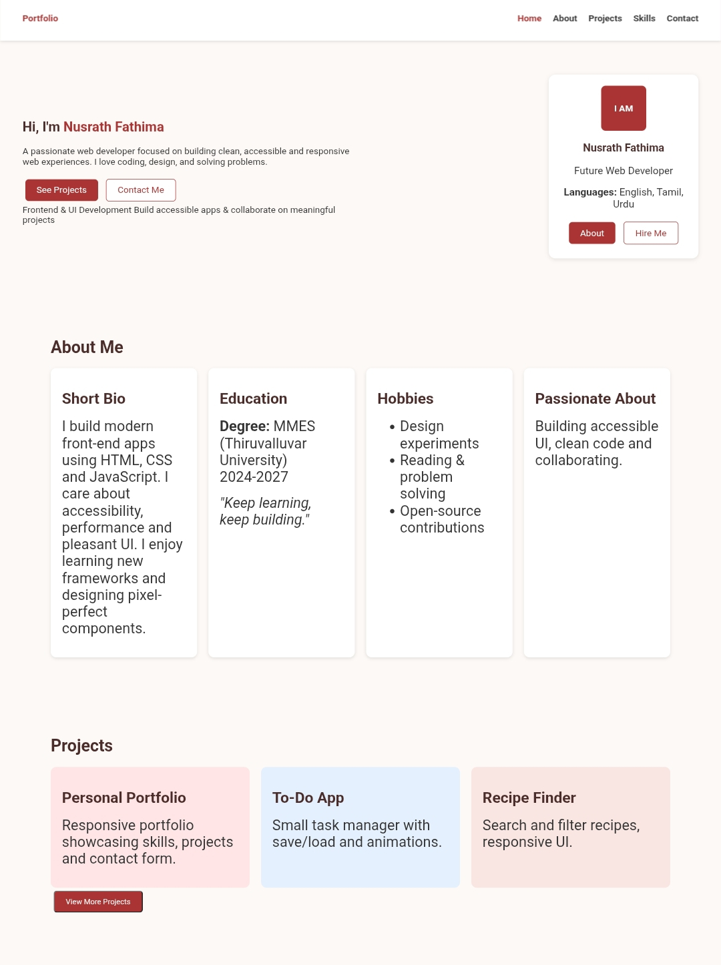
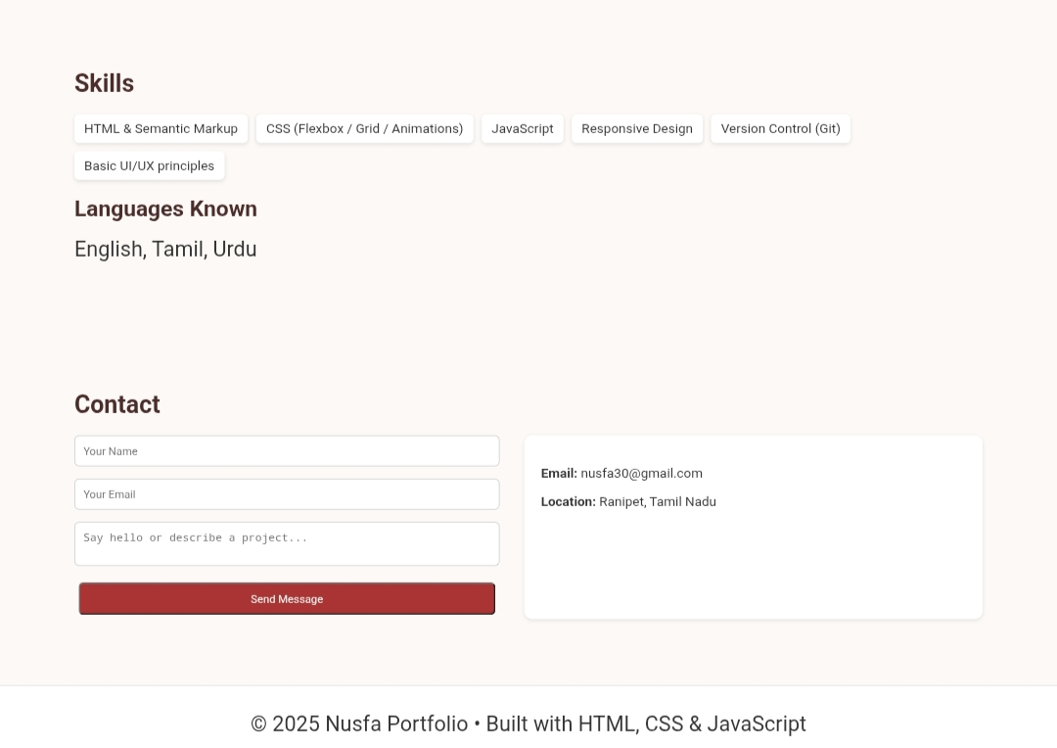
RESULTS AND SCREENSHOTS:

Slide 10
CONCLUSION:
•𝓐 𝓹𝓸𝓻𝓽𝓯𝓸𝓵𝓲𝓸 𝓹𝓻𝓸𝓿𝓲𝓭𝓮𝓼 𝓪 𝔀𝓪𝔂 𝓽𝓸
1.𝓣𝓸𝓫 𝓗𝓾𝓷𝓽𝓲𝓷𝓰.
2.𝓢𝓱𝓸𝔀𝓬𝓪𝓼𝓮 𝓽𝓱𝓸𝓾𝓰𝓱𝓽 𝓹𝓻𝓸𝓬𝓮𝓼𝓼.
•𝓟𝓸𝓻𝓽𝓯𝓸𝓵𝓲𝓸 𝓫𝓾𝓲𝓵𝓭𝓼 𝓽𝓻𝓾𝓼𝓽 𝓪𝓷𝓭 𝓭𝓮𝓶𝓸𝓼𝓽𝓻𝓪𝓽𝓮 𝓿𝓪𝓵𝓾𝓮 𝓽𝓸 𝔀𝓸𝓻𝓴.
•𝓟𝓸𝓻𝓽𝓯𝓸𝓵𝓲𝓸 𝓹𝓻𝓸𝓿𝓲𝓭𝓮 𝓷𝓮𝔀 𝓷𝓮𝓽𝔀𝓸𝓻𝓴 𝓪𝓷𝓭 𝓬𝓸𝓵𝓵𝓪𝓫𝓸𝓻𝓪𝓽𝓲𝓸𝓷 𝓽𝓸 𝔀𝓸𝓻𝓴 𝓸𝓷 𝓭𝓲𝓯𝓯𝓮𝓻𝓮𝓷𝓽 𝓯𝓲𝓮𝓵𝓭𝓼.

Slide 11
GIT – HUB LINK:
𝓟𝓡𝓞𝓙𝓔𝓒𝓣 𝓛𝓘𝓝𝓚 :https://github.com/mohdsami2-hub/Nusrath-Portfolio-Project

